Slide 1
Proclamation Day of the Republic of Latvia
Here is where your presentation begins

Slide 2
Contents of this template
You can delete this slide when you’re done editing the presentation
Fonts | To view this template correctly in PowerPoint, download and install the fonts we used
Used and alternative resources | An assortment of graphic resources that are suitable for use in this presentation
Thanks slide | You must keep it so that proper credits for our design are given
Colors | All the colors used in this presentation
Icons and infographic resources | These can be used in the template, and their size and color can be edited
Editable presentation theme | You can edit the master slides easily. For more info, click here
For more info:
SLIDESGO | SLIDESGO SCHOOL | FAQs
You can visit our sister projects:
FREEPIK | FLATICON | STORYSET | WEPIK | VIDEVO

Slide 3
Table of contents
About the culture
The country
1
2
The population
Conclusions
3
4
You can describe the topic of the section here
You can describe the topic of the section here
You can describe the topic of the section here
You can describe the topic of the section here

Slide 4
Whoa!
This can be the part of the presentation where you introduce yourself, write your email…

Slide 5
Historical buildings
Mercury
Venus
Mars
It’s the closest planet to the Sun and the smallest in the Solar System
Venus has a beautiful name and is the second planet from the Sun
Despite being red, Mars is actually a cold place. It’s full of iron oxide dust

Slide 6
1
About the culture
You can enter a subtitle here if you need it

Slide 7
About the Republic of Latvia
Do you know what helps you make your point clear? Lists like this one:
They’re simple
You can organize your ideas clearly
You’ll never forget to buy milk!
And the most important thing: the audience won’t miss the point of your presentation

Slide 8
Nature reserve
Mercury
Venus
Mercury is the closest planet to the Sun and the smallest one in the Solar System—it’s only a bit larger than the Moon
Venus has a beautiful name and is the second planet from the Sun. It’s hot and has a poisonous atmosphere

Slide 9
Principal features of celebration
Festivals
Wine
Sports
Music
Mars is actually a very cold place
Venus is the second planet from the Sun
Jupiter is the biggest planet of them all
Saturn is a gas giant and has rings

Slide 10
Principal food for celebration
Mars
Venus
Neptune
Mercury
Saturn
Jupiter
Mars is actually a very cold place
Venus is the second planet from the Sun
It’s the farthest planet from the Sun
It’s the closest planet to the Sun
Saturn is a gas giant with several rings
Jupiter is the biggest planet of them all

Slide 11
Awesome words

Slide 12
—Someone Famous
“This is a quote, words full of wisdom that someone important said and can make the reader get inspired.”

Slide 13
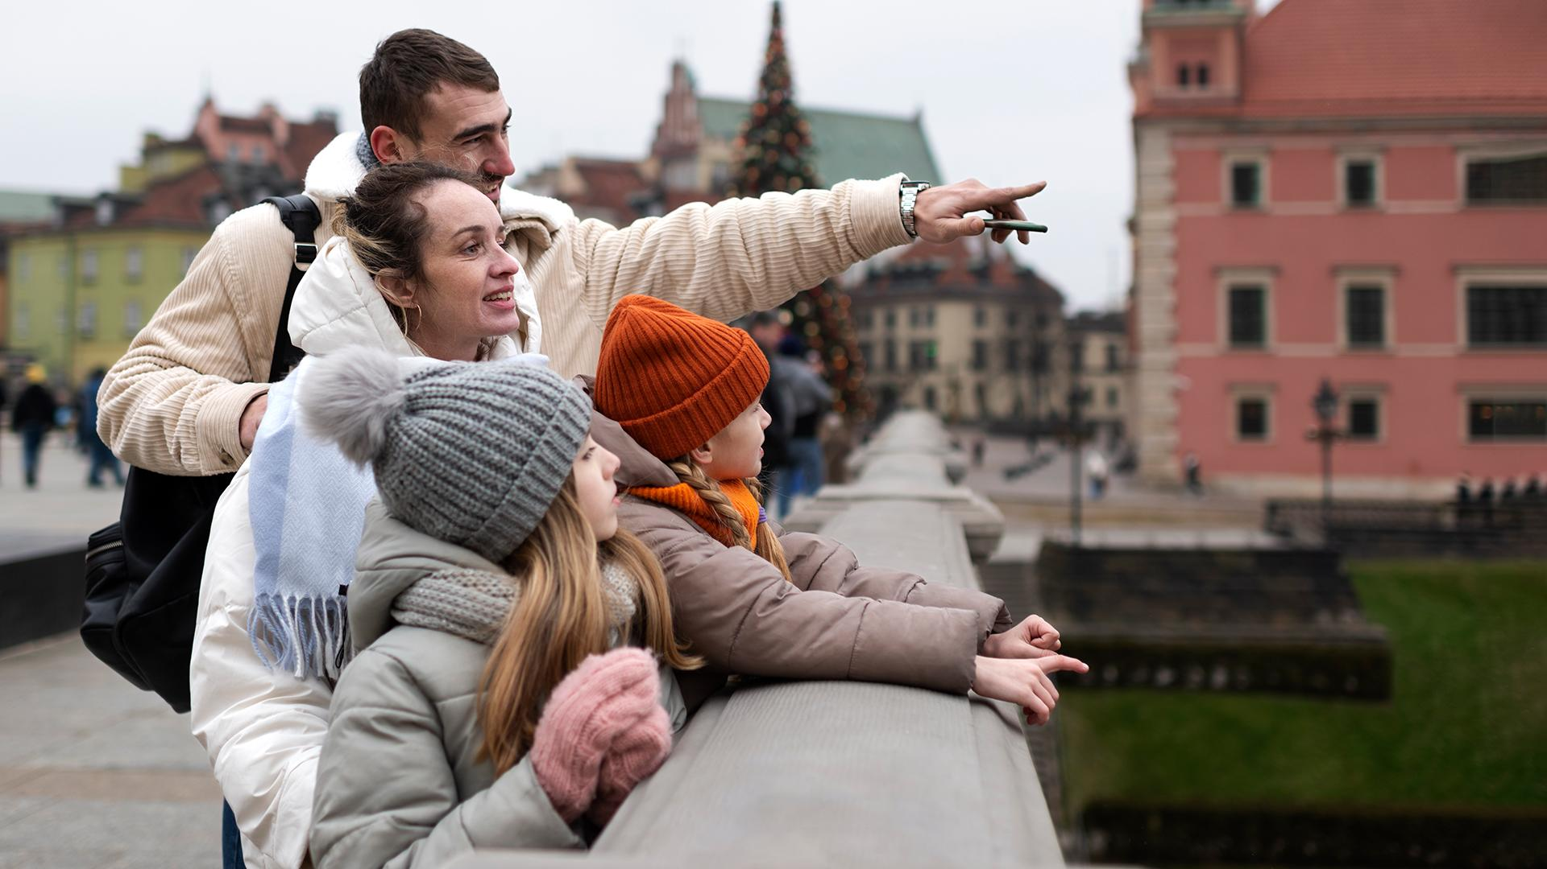
A picture is worth a thousand words

Slide 14
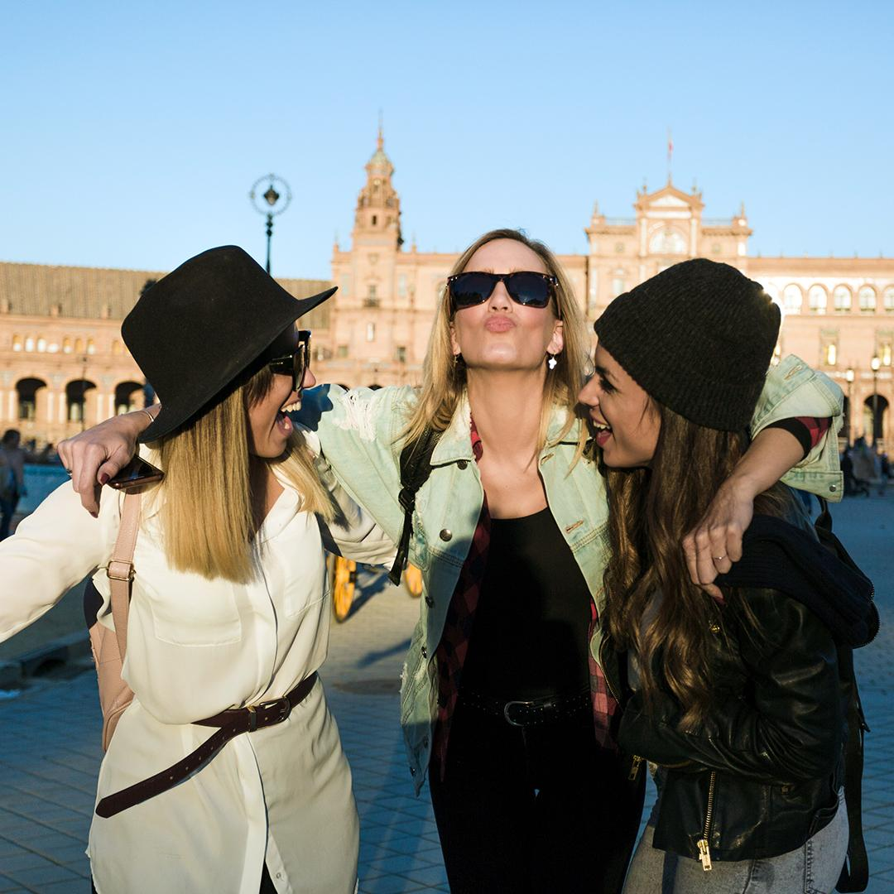
To reinforce the concept, try using an image
Images reveal large amounts of data, so remember: use an image instead of a long text. Your audience will appreciate it

Slide 15
150,000
Big numbers catch your audience’s attention

Slide 16
9h 55m 23s
333,000
Jupiter's rotation period
The Sun’s mass compared to Earth’s

Slide 17
Stats of tourism in the country
25%
50%
Mercury
Venus
Mercury is the closest planet to the Sun and the smallest one in the Solar System—it’s only a bit larger than the Moon
Venus has a beautiful name and is the second planet from the Sun. It’s hot and has a poisonous atmosphere

Slide 18
Location of the Republic of Latvia
Latvia
Mercury is the closest planet to the Sun and the smallest one in the Solar System—it’s only a bit larger than the Moon

Slide 19
History of Latvia's National Day
1918
1990
1991
Today
Mercury is a very small planet
Neptune is far away from us
Mars is full of iron oxide dust
Jupiter is a gas giant and it’s big

Slide 20
About the Latvian flag
Music
Population
Venus has a beautiful name
Jupiter is a gas giant and it’s big
Language
Food
Mars is a cold and red planet
Saturn is a gas giant with rings

Slide 21
November 18th
Day of the Republic of Latvia

Slide 22
The country
2
You can enter a subtitle here if you need it

Slide 23
Government policies
Mercury is the closest planet to the Sun and the smallest one in the entire Solar System. This planet's name has nothing to do with the liquid metal, since Mercury was named after the Roman messenger god. Despite being closer to the Sun than Venus, its temperatures aren't as terribly hot as that planet's. Its surface is quite similar to that of Earth's Moon, which means there are a lot of craters and plains
Speaking of craters, many of them were named after artists or authors who made significant contributions to their respective fields. Mercury takes a little more than 58 days to complete its rotation, so try to imagine how long days must be there! Since the temperatures are so extreme, albeit not as extreme as in Venus, and the solar radiation is so high, Mercury has been deemed to be non-habitable for humans

Slide 24
Process of celebration
Step 1
Step 2
Step 3
Step 4
Step 5
Mercury is a small planet
Mars is a cold and red planet
Earth is the planet with life
Neptune is far away from us
Jupiter is a very big planet

Slide 25
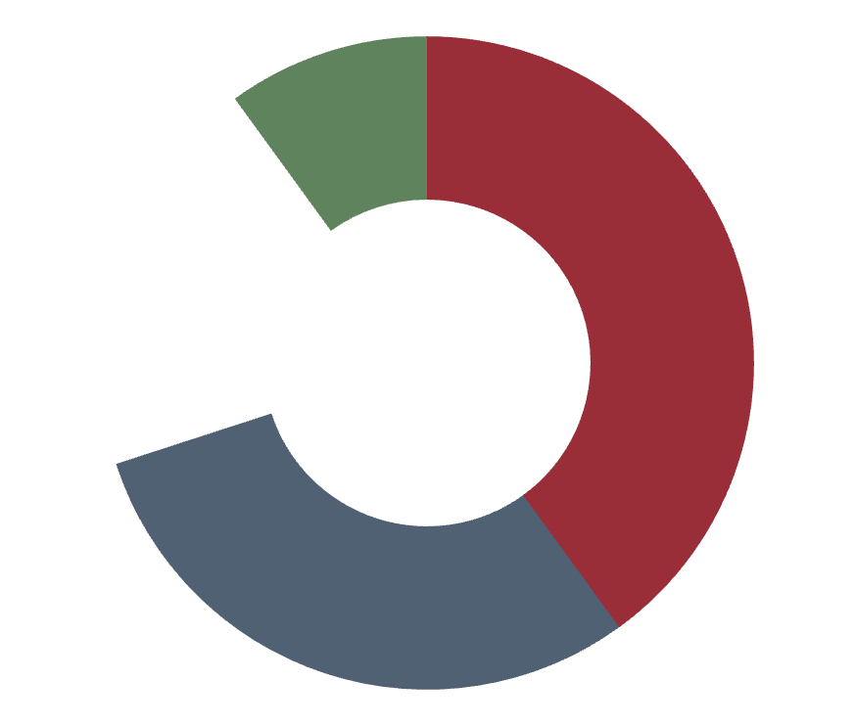
Principal activities
20%
10%
30%
40%
Concerts
Games
Shopping
Tours
Venus has a beautiful name
Mercury is very close to the Sun
Jupiter is a very big planet
Mars is a cold and red planet
Follow the link in the graph to modify its data and then paste the new one here. For more info, click here

Slide 26
Flora and fauna elements
Mars
Neptune
Mercury
Saturn
Jupiter
Venus
Mars is actually a very cold place
It’s the farthest planet from the Sun
It’s the closest planet to the Sun
Saturn is a gas giant with several rings
Jupiter is the biggest planet of them all
Venus is the second planet from the Sun

Slide 27
Political organization
President
Jupiter is the biggest planet in the System
Legislative
Judicial
Saturn is not the only planet with rings
Neptune is very far away from the Sun

Slide 28
Independence factors
Mercury is the closest planet to the Sun and the smallest one in the Solar System—it’s only a bit larger than the Moon

Slide 29
Gastronomy features
Mercury
Venus
Despite being red, Mars is actually a cold place. It’s full of iron oxide dust
Mercury is the closest planet to the Sun and the smallest one in the Solar System
Venus has a beautiful name and is the second planet from the Sun

